Slide 1


Analyzing Clinical and Genomic Oncological Data with {genieBPC} and {gnomeR}
GENIE BPC Winter Symposium
January 16, 2024
Sammi Brown
Hannah Fuchs
Jessica Lavery
Karissa Whiting

Slide 2
Agenda
Clinico-Genomic Data Processing Pipeline
Case study
Genomic data processing with {gnomeR}
Conclusion
Clinical data processing with {genieBPC}

Slide 3



Projects GENIE & GENIE BPC
The goal of Project GENIE Biopharma Collaborative (BPC) is to augment the existing registry genomic data from AACR Project GENIE with enhanced clinical (phenomic) data to support clinical-genomics analyses.
Phenomic data are curated using the PRISSMM curation model to capture detailed information on cancer diagnosis, drug regimens, disease status from radiology reports, pathology reports and medical oncologist assessments, structured in several datasets with over 700 feature variables.
Analyses using linked clinico-genomic databases – including GENIE BPC – will help to drive advancements in precision oncology in identifying the genomic alterations and drug therapies that optimize clinical outcomes.

Slide 4
Genomic data included in GENIE
The AACR Project GENIE data repository is comprised of one type of genomic data called tumor DNA sequencing assays
Collected from tumor samples via biopsy/resection
Compare DNA sequence in cancer cells with that in normal cells
Sequencing assays can be broad or targeted
Broad regions: whole genome/whole exome sequencing
Targeted regions: gene panels
GENIE data consists of data from targeted gene panels from high-throughput (huge amounts of data) sequencing assays, also referred to as next-generation sequencing (NGS)
Researchers receive genomic data in different formats and types
Notes:
Adapted from H:\Biostatistics\Research Biostatistician Training\Intro to Genomics & IMPACT\Intro to Cancer Genomics & IMPACT data Part I 083022.pptx

Slide 5
GENIE BPC Data
Data are publicly released by cancer cohort: non-small cell lung (NSCLC), colorectal (CRC), breast, pancreas, prostate, bladder
New versions of data are released periodically to include additional patients and variables and to incorporate data corrections
.csv and .txt data files are available for download from Sage Bionetworks’ Synapse data sharing platform
Downloading each file individually poses challenges for efficient and reproducible workflows

Slide 6




{genieBPC} & {gnomeR} R Packages
Created and developed by
The {genieBPC} package is a pipeline to programmatically access the data corresponding to each release from Synapse to support reproducibility, and to create datasets linking clinical and genomic data for analysis.
Created and developed by
The {gnomeR} package provides a consistent framework for genetic data wrangling, processing, visualization and analysis.
Samantha Brown
Michael Curry
Hannah Fuchs
Jessica Lavery
Axel Martin
Dan Sjoberg
Karissa Whiting
Arshi Arora
Michael Curry
Hannah Fuchs
Axel Martin
Karissa Whiting
Notes:
*Emphasize purpose of gnomeR and ability for analysis and for figure customization

Slide 7
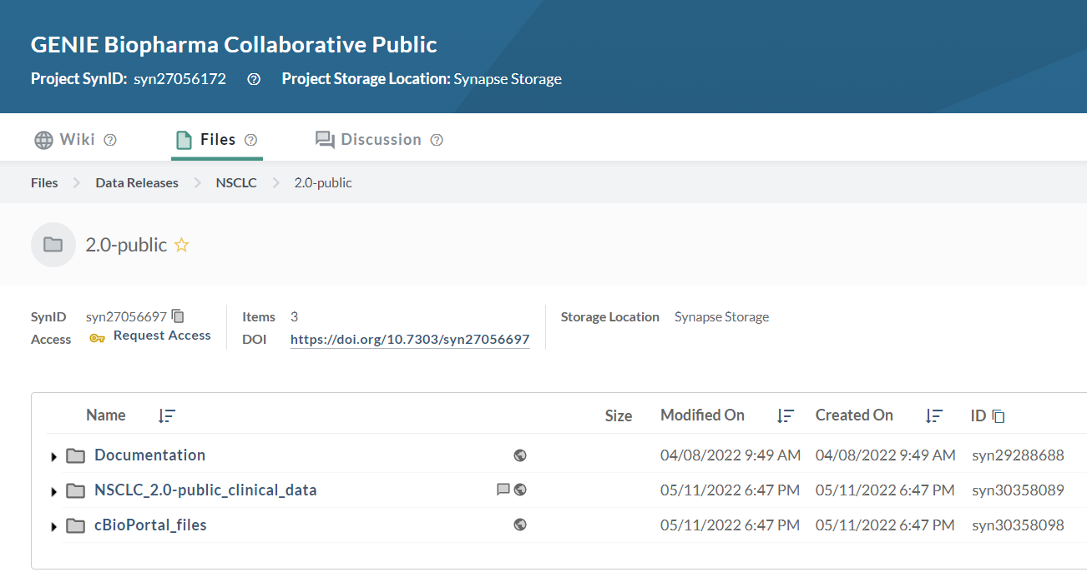

Register for Synapse Account
Instructions:
Register for a ‘Synapse’ account. Be sure to create a username and password. Do NOT connect via your Google account.
https://www.synapse.org/#
Accept the Synapse account terms of use.
Navigate to GENIE Biopharma Collaborative Public page
https://www.synapse.org/#!Synapse:syn27056172/wiki/616601
In the Files folder, navigate to Data Releases → NSCLC → 2.0-public
Select Request Access, review the terms of data use and click Accept
Notes:
RMedicine: JL to send link to Synapse instructions in chat

Slide 8
Installation Instructions
Installing {genieBPC}:
install.packages("genieBPC")
These instructions are also included in the Demo.R script on our GitHub repository: https://github.com/GENIE-BPC/intro_to_genieBPC_and_gnomeR
Further R package details are available on the {genieBPC} GitHub repo & website
{genieBPC} requires R version >=3.6
Notes:
Stop here for 5 mins

Slide 9


Clinico-Genomic Data Processing Pipeline
Data stored on
Data import
synapse_version()
Indicates the versions of the data that are available to be specified in pull_data_synapse()
pull_data_synapse()
Imports GENIE BPC data from Synapse into the R environment
Data processing
create_analytic_cohort()
Selects an analytic cohort based on cancer diagnosis information and/or cancer-directed drug regimen information
select_unique_ngs()
Selects a unique next generation sequencing (NGS) test corresponding to the selected diagnoses
Data visualization
drug_regimen_sunburst()
Creates a sunburst figure of drug regimen information corresponding to the selected diagnoses in the order that the regimens were administered
Genomic Processing
{gnomeR}
create_gene_binary()
Processes data on mutation, CNA and fusions into analytic format
tbl_genomic()
Summarizes gene alterations across clinical variables of interest

Slide 10
Case Study
Create a cohort of patients who were diagnosed with Stage IV adenocarcinoma non-small cell lung cancer (NSCLC) and received Carboplatin and Pemetrexed +/- Bevacizumab or Cisplatin and Pemetrexed +/- Bevacizumab as their first cancer-directed drug regimen after diagnosis.
Follow along using the Demo.R script on our GitHub repository: https://github.com/GENIE-BPC/intro_to_genieBPC_and_gnomeR
Notes:
Case study will demonstrate how to use pull_data_synapse(), create_analytic_cohort() and select_unique_ngs() functions from {genieBPC} to process the clinical data and visualize treatment data can be visualized in sunburst plot
Will then transition to demo for processing and visualizing genomic data using {gnomeR}

Slide 11
Clinico-Genomic Data Processing Pipeline
Data stored on
Data import
synapse_version()
Indicates the versions of the data that are available to be specified in pull_data_synapse()
pull_data_synapse()
Imports GENIE BPC data from Synapse into the R environment
Data processing
create_analytic_cohort()
Selects an analytic cohort based on cancer diagnosis information and/or cancer-directed drug regimen information
select_unique_ngs()
Selects a unique next generation sequencing (NGS) test corresponding to the selected diagnoses
Data visualization
drug_regimen_sunburst()
Creates a sunburst figure of drug regimen information corresponding to the selected diagnoses in the order that the regimens were administered
Genomic Processing
{gnomeR}
create_gene_binary()
Processes data on mutation, CNA and fusions into analytic format
tbl_genomic()
Summarizes gene alterations across clinical variables of interest

Slide 12
Set Synapse Credentials
To pull data from Synapse, users must create a Synapse account and store their Synapse credentials in the R environment. The set_synapse_credentials() function will store credentials during each R session:
set_synapse_credentials(username = ‘your_username’,
password = ‘your_password’)

Slide 13
Set Synapse Credentials
To pull data from Synapse, users must create a Synapse account and store their Synapse credentials in the R environment. The set_synapse_credentials() function will store credentials during each R session:
set_synapse_credentials(username = ‘your_username’,
password = ‘your_password’)
Coming soon
Additional functionality will be released soon to allow users to pass their Synapse Personal Access Token (PAT) through set_synapse_credentials():
set_synapse_credentials(pat = ‘your_pat’)
Notes:
Coming soon: access via PAT

Slide 14
synapse_version()
Helper function that returns a table of GENIE BPC data releases that are currently available
synapse_version() has one input: most_recent = TRUE/FALSE
Calling genieBPC::synapse_version(most_recent = TRUE) will return a table with each cancer cohort and its latest data release version
Calling genieBPC::synapse_version(most_recent = FALSE) will return a table with all cancer cohorts and data releases available

Slide 15
synapse_version()
Helper function that returns a table of GENIE BPC data releases that are currently available
synapse_version() has one input: most_recent = TRUE/FALSE
Calling genieBPC::synapse_version(most_recent = TRUE) will return a table with each cancer cohort and its latest data release version
Calling genieBPC::synapse_version(most_recent = FALSE) will return a table with all cancer cohorts and data releases available
synapse_version(most_recent = TRUE)
cohort | version | release_date | all_versions
BLADDER | v1.2-consortium | November 2023 | Most Recent Versions
BrCa | v1.2-consortium | October 2022 | Most Recent Versions
CRC | v1.2-consortium | August 2021 | Most Recent Versions
CRC | v2.0-public | October 2022 | Most Recent Versions
NSCLC | v2.1-consortium | August 2021 | Most Recent Versions
NSCLC | v2.0-public | May 2022 | Most Recent Versions
PANC | v1.2-consortium | January 2023 | Most Recent Versions
Prostate | v1.2-consortium | January 2023 | Most Recent Versions
Notes:
Per cohort and level of access (consortium vs. public)

Slide 16
pull_data_synapse()
Pull GENIE BPC clinical and genomic data directly from Synapse into R
Can specify cancer type (`cohort`) and version of data (`version`)
Version of the data is updated periodically on Synapse with re-releases (new variables available, additional QA, etc.)
Returns a nested list of data frames for each cancer site for the accompanying version
Argument | Description | Acceptable Values
cohort | GENIE BPC Project cancer Currently, NSCLC and CRC are the only two publicly available datasets | NSCLC CRC BrCa PANC Prostate BLADDER
version | Version of the data (e.g v1.1-consortium, v2.0-public) | Values can be found in synapse_version()
Notes:
Version updates and new sites

Slide 17


Demo: Run pull_data_synapse() for case study
library(genieBPC)
set_synapse_credentials()
nsclc_synapse_data <- pull_data_synapse(cohort = "NSCLC", version = "v2.0-public")

Slide 18
Demo: Run pull_data_synapse() for case study
library(genieBPC)
set_synapse_credentials()
nsclc_synapse_data <- pull_data_synapse(cohort = "NSCLC", version = "v2.0-public")

Slide 19
Demo: Run pull_data_synapse() for case study
library(genieBPC)
set_synapse_credentials()
nsclc_synapse_data <- pull_data_synapse(cohort = "NSCLC", version = "v2.0-public")

Slide 20
Demo: Run pull_data_synapse() for case study
library(genieBPC)
set_synapse_credentials()
nsclc_synapse_data <- pull_data_synapse(cohort = "NSCLC", version = "v2.0-public")

Slide 21
Demo: Run pull_data_synapse() for case study
library(genieBPC)
set_synapse_credentials()
nsclc_synapse_data <- pull_data_synapse(cohort = "NSCLC", version = "v2.0-public")
Calling nsclc_synapse_data$NSCLC_v2.0 returns a list of datasets in nsclc_synapse_data:
pt_char
ca_dx_index
ca_dx_non_index
ca_drugs
prissmm_pathology
prissmm_imaging
prissmm_md
cpt
mutations_extended
cna
fusions

Slide 22
Clinico-Genomic Data Processing Pipeline
Data stored on
Data import
synapse_version()
Indicates the versions of the data that are available to be specified in pull_data_synapse()
pull_data_synapse()
Imports GENIE BPC data from Synapse into the R environment
Data processing
create_analytic_cohort()
Selects an analytic cohort based on cancer diagnosis information and/or cancer-directed drug regimen information
select_unique_ngs()
Selects a unique next generation sequencing (NGS) test corresponding to the selected diagnoses
Data visualization
drug_regimen_sunburst()
Creates a sunburst figure of drug regimen information corresponding to the selected diagnoses in the order that the regimens were administered
Genomic Processing
{gnomeR}
create_gene_binary()
Processes data on mutation, CNA and fusions into analytic format
tbl_genomic()
Summarizes gene alterations across clinical variables of interest

Slide 23
create_analytic_cohort()
Create a cohort from the GENIE BPC data
Cancer diagnosis information such as cancer cohort, treating institution, histology, and stage at diagnosis
Cancer-directed regimen information including regimen name and regimen order.
This function returns all clinical and genomic data for the selected patients

Slide 24
create_analytic_cohort()
Argument | Description | Acceptable Values
data_synapse | List returned from pull_data_synapse() | Name of object in global environment that was returned from pull_data_synapse()

Slide 25
create_analytic_cohort()
Argument | Description | Acceptable Values
data_synapse | List returned from pull_data_synapse() | Name of object in global environment that was returned from pull_data_synapse()
index_ca_seq | Index cancer sequence. Default is 1, indicating the patient's first index cancer. This is the cancer that met the eligibility criteria for the project and was selected at random for PRISSMM phenomic data curation. | Numeric (1+)
Notes:
Should we skip talking about index cancers?

Slide 26
create_analytic_cohort()
Argument | Description | Acceptable Values
data_synapse | List returned from pull_data_synapse() | Name of object in global environment that was returned from pull_data_synapse()
index_ca_seq | Index cancer sequence. Default is 1, indicating the patient's first index cancer. This is the cancer that met the eligibility criteria for the project and was selected at random for PRISSMM phenomic data curation. | Numeric (1+)
institution | GENIE BPC participating institution. Default selection is all institutions. Note that not all institutions curated data for all cancer sites. | DFCI MSK UHN VICC

Slide 27
create_analytic_cohort()
Argument | Description | Acceptable Values
stage_dx | Stage at diagnosis. Default selection is all stages. | Stage I Stage II Stage III Stage I-III NOS Stage IV

Slide 28
create_analytic_cohort()
Argument | Description | Acceptable Values
stage_dx | Stage at diagnosis. Default selection is all stages. | Stage I Stage II Stage III Stage I-III NOS Stage IV
histology | Cancer histology. Default selection is all histologies. For all cancer cohorts except for BrCa (breast cancer), this parameter corresponds to the variable 'ca_hist_adeno_squamous’. For BrCa, this parameter corresponds to the variable 'ca_hist_brca' | All cancer types except breast: Adenocarcinoma Squamous cell Sarcoma Small cell carcinoma Other histologies/mixed tumor Breast cancer: Invasive lobular carcinoma Invasive ductal carcinoma Other histology

Slide 29
create_analytic_cohort()
Argument | Description | Acceptable Values
regimen_drugs | Vector with names of drugs in cancer-directed regimen, separated by a comma. For example, to specify a regimen consisting of Carboplatin and Pemetrexed Disodium, specify regimen_drugs = "Carboplatin, Pemetrexed Disodium". | Acceptable values are found in the drug_names_by_cohort dataset provided with this package.
regimen_type | Indicates whether the regimen(s) specified in regimen_drugs indicates the exact regimen to return, or if regimens containing the drugs listed in regimen_drugs should be returned. | Exact Containing

Slide 30
Example: regimen_drugs and regimen_type
regimen_drugs | regimen_type | Example regimens returned
Carboplatin | Exact | Carboplatin
Carboplatin | Containing | Carboplatin Carboplatin, Cisplatin Carboplatin, Paclitaxel Carboplatin, Pemetrexed Disodium etc.

Slide 31
create_analytic_cohort()
Argument | Description | Acceptable Values
regimen_order | Order of cancer-directed regimen. If multiple drugs are specified, regimen_order indicates the regimen order for all drugs; different values of regimen_order cannot be specified for different drug regimens. | Numeric (1+)
regimen_order_type | Specifies whether the 'regimen_order' parameter refers to the order of receipt of the drug regimen within the cancer diagnosis (across all other drug regimens; "within cancer") or the order of receipt of the drug regimen within the times that that drug regimen was administered (e.g. the first time carboplatin pemetrexed was received, out of all times that the patient received carboplatin pemetrexed; "within regimen"). | Within cancer Within regimen

Slide 32
create_analytic_cohort()
Argument | Description | Acceptable Values
return_summary | Specifies whether summary tables are returned using {gtsummary}. Default is FALSE. | TRUE FALSE

Slide 33
Demo: create_analytic_cohort() for case study using NSCLC 2.0-public data
nsclc_cohort <- create_analytic_cohort(
data_synapse = nsclc_synapse_data$NSCLC_v2.0,
stage_dx = c("Stage IV"),
histology = "Adenocarcinoma",
regimen_drugs = c("Carboplatin, Pemetrexed Disodium",
"Cisplatin, Pemetrexed Disodium",
"Bevacizumab, Carboplatin, Pemetrexed Disodium",
"Bevacizumab, Cisplatin, Pemetrexed Disodium"),
regimen_type = "Exact",
regimen_order = 1,
regimen_order_type = "within cancer",
return_summary = TRUE
)
Case Study: Create a cohort of patients who were diagnosed with Stage IV adenocarcinoma NSCLC and received Carboplatin and Pemetrexed +/- Bevacizumab or Cisplatin and Pemetrexed +/- Bevacizumab as their first cancer-directed drug regimen after diagnosis

Slide 34
Demo: create_analytic_cohort() for case study using NSCLC 2.0-public data
nsclc_cohort <- create_analytic_cohort(
data_synapse = nsclc_synapse_data$NSCLC_v2.0,
stage_dx = c("Stage IV"),
histology = "Adenocarcinoma",
regimen_drugs = c("Carboplatin, Pemetrexed Disodium",
"Cisplatin, Pemetrexed Disodium",
"Bevacizumab, Carboplatin, Pemetrexed Disodium",
"Bevacizumab, Cisplatin, Pemetrexed Disodium"),
regimen_type = "Exact",
regimen_order = 1,
regimen_order_type = "within cancer",
return_summary = TRUE
)
Case Study: Create a cohort of patients who were diagnosed with Stage IV adenocarcinoma NSCLC and received Carboplatin and Pemetrexed +/- Bevacizumab or Cisplatin and Pemetrexed +/- Bevacizumab as their first cancer-directed drug regimen after diagnosis

Slide 35
Demo: create_analytic_cohort() for case study using NSCLC 2.0-public data
nsclc_cohort <- create_analytic_cohort(
data_synapse = nsclc_synapse_data$NSCLC_v2.0,
stage_dx = c("Stage IV"),
histology = "Adenocarcinoma",
regimen_drugs = c("Carboplatin, Pemetrexed Disodium",
"Cisplatin, Pemetrexed Disodium",
"Bevacizumab, Carboplatin, Pemetrexed Disodium",
"Bevacizumab, Cisplatin, Pemetrexed Disodium"),
regimen_type = "Exact",
regimen_order = 1,
regimen_order_type = "within cancer",
return_summary = TRUE
)
Case Study: Create a cohort of patients who were diagnosed with Stage IV adenocarcinoma NSCLC and received Carboplatin and Pemetrexed +/- Bevacizumab or Cisplatin and Pemetrexed +/- Bevacizumab as their first cancer-directed drug regimen after diagnosis

Slide 36
Demo: create_analytic_cohort() for case study using NSCLC 2.0-public data
nsclc_cohort <- create_analytic_cohort(
data_synapse = nsclc_synapse_data$NSCLC_v2.0,
stage_dx = c("Stage IV"),
histology = "Adenocarcinoma",
regimen_drugs = c("Carboplatin, Pemetrexed Disodium",
"Cisplatin, Pemetrexed Disodium",
"Bevacizumab, Carboplatin, Pemetrexed Disodium",
"Bevacizumab, Cisplatin, Pemetrexed Disodium"),
regimen_type = "Exact",
regimen_order = 1,
regimen_order_type = "within cancer",
return_summary = TRUE
)
Case Study: Create a cohort of patients who were diagnosed with Stage IV adenocarcinoma NSCLC and received Carboplatin and Pemetrexed +/- Bevacizumab or Cisplatin and Pemetrexed +/- Bevacizumab as their first cancer-directed drug regimen after diagnosis

Slide 37
Demo: create_analytic_cohort() for case study using NSCLC 2.0-public data
nsclc_cohort <- create_analytic_cohort(
data_synapse = nsclc_synapse_data$NSCLC_v2.0,
stage_dx = c("Stage IV"),
histology = "Adenocarcinoma",
regimen_drugs = c("Carboplatin, Pemetrexed Disodium",
"Cisplatin, Pemetrexed Disodium",
"Bevacizumab, Carboplatin, Pemetrexed Disodium",
"Bevacizumab, Cisplatin, Pemetrexed Disodium"),
regimen_type = "Exact",
regimen_order = 1,
regimen_order_type = "within cancer",
return_summary = TRUE
)
Case Study: Create a cohort of patients who were diagnosed with Stage IV adenocarcinoma NSCLC and received Carboplatin and Pemetrexed +/- Bevacizumab or Cisplatin and Pemetrexed +/- Bevacizumab as their first cancer-directed drug regimen after diagnosis

Slide 38
Demo: create_analytic_cohort() for case study using NSCLC 2.0-public data
nsclc_cohort <- create_analytic_cohort(
data_synapse = nsclc_synapse_data$NSCLC_v2.0,
stage_dx = c("Stage IV"),
histology = "Adenocarcinoma",
regimen_drugs = c("Carboplatin, Pemetrexed Disodium",
"Cisplatin, Pemetrexed Disodium",
"Bevacizumab, Carboplatin, Pemetrexed Disodium",
"Bevacizumab, Cisplatin, Pemetrexed Disodium"),
regimen_type = "Exact",
regimen_order = 1,
regimen_order_type = "within cancer",
return_summary = TRUE
)
Case Study: Create a cohort of patients who were diagnosed with Stage IV adenocarcinoma NSCLC and received Carboplatin and Pemetrexed +/- Bevacizumab or Cisplatin and Pemetrexed +/- Bevacizumab as their first cancer-directed drug regimen after diagnosis

Slide 39
Demo: create_analytic_cohort() for case study using NSCLC 2.0-public data
nsclc_cohort <- create_analytic_cohort(
data_synapse = nsclc_synapse_data$NSCLC_v2.0,
stage_dx = c("Stage IV"),
histology = "Adenocarcinoma",
regimen_drugs = c("Carboplatin, Pemetrexed Disodium",
"Cisplatin, Pemetrexed Disodium",
"Bevacizumab, Carboplatin, Pemetrexed Disodium",
"Bevacizumab, Cisplatin, Pemetrexed Disodium"),
regimen_type = "Exact",
regimen_order = 1,
regimen_order_type = "within cancer",
return_summary = TRUE
)
Case Study: Create a cohort of patients who were diagnosed with Stage IV adenocarcinoma NSCLC and received Carboplatin and Pemetrexed +/- Bevacizumab or Cisplatin and Pemetrexed +/- Bevacizumab as their first cancer-directed drug regimen after diagnosis

Slide 40
Demo: create_analytic_cohort() for case study using NSCLC 2.0-public data
nsclc_cohort <- create_analytic_cohort(
data_synapse = nsclc_synapse_data$NSCLC_v2.0,
stage_dx = c("Stage IV"),
histology = "Adenocarcinoma",
regimen_drugs = c("Carboplatin, Pemetrexed Disodium",
"Cisplatin, Pemetrexed Disodium",
"Bevacizumab, Carboplatin, Pemetrexed Disodium",
"Bevacizumab, Cisplatin, Pemetrexed Disodium"),
regimen_type = "Exact",
regimen_order = 1,
regimen_order_type = "within cancer",
return_summary = TRUE
)
Case Study: Create a cohort of patients who were diagnosed with Stage IV adenocarcinoma NSCLC and received Carboplatin and Pemetrexed +/- Bevacizumab or Cisplatin and Pemetrexed +/- Bevacizumab as their first cancer-directed drug regimen after diagnosis

Slide 41
Demo: create_analytic_cohort() for case study using NSCLC 2.0-public data
nsclc_cohort <- create_analytic_cohort(
data_synapse = nsclc_synapse_data$NSCLC_v2.0,
stage_dx = c("Stage IV"),
histology = "Adenocarcinoma",
regimen_drugs = c("Carboplatin, Pemetrexed Disodium",
"Cisplatin, Pemetrexed Disodium",
"Bevacizumab, Carboplatin, Pemetrexed Disodium",
"Bevacizumab, Cisplatin, Pemetrexed Disodium"),
regimen_type = "Exact",
regimen_order = 1,
regimen_order_type = "within cancer",
return_summary = TRUE
)
Case Study: Create a cohort of patients who were diagnosed with Stage IV adenocarcinoma NSCLC and received Carboplatin and Pemetrexed +/- Bevacizumab or Cisplatin and Pemetrexed +/- Bevacizumab as their first cancer-directed drug regimen after diagnosis

Slide 42
Demo: create_analytic_cohort() for case study using NSCLC 2.0-public data
nsclc_cohort <- create_analytic_cohort(
data_synapse = nsclc_synapse_data$NSCLC_v2.0,
stage_dx = c("Stage IV"),
histology = "Adenocarcinoma",
regimen_drugs = c("Carboplatin, Pemetrexed Disodium",
"Cisplatin, Pemetrexed Disodium",
"Bevacizumab, Carboplatin, Pemetrexed Disodium",
"Bevacizumab, Cisplatin, Pemetrexed Disodium"),
regimen_type = "Exact",
regimen_order = 1,
regimen_order_type = "within cancer",
return_summary = TRUE
)
Case Study: Create a cohort of patients who were diagnosed with Stage IV adenocarcinoma NSCLC and received Carboplatin and Pemetrexed +/- Bevacizumab or Cisplatin and Pemetrexed +/- Bevacizumab as their first cancer-directed drug regimen after diagnosis

Slide 43
Demo: create_analytic_cohort() for case study using NSCLC 2.0-public data
nsclc_cohort <- create_analytic_cohort(
data_synapse = nsclc_synapse_data$NSCLC_v2.0,
stage_dx = c("Stage IV"),
histology = "Adenocarcinoma",
regimen_drugs = c("Carboplatin, Pemetrexed Disodium",
"Cisplatin, Pemetrexed Disodium",
"Bevacizumab, Carboplatin, Pemetrexed Disodium",
"Bevacizumab, Cisplatin, Pemetrexed Disodium"),
regimen_type = "Exact",
regimen_order = 1,
regimen_order_type = "within cancer",
return_summary = TRUE
)
Case Study: Create a cohort of patients who were diagnosed with Stage IV adenocarcinoma NSCLC and received Carboplatin and Pemetrexed +/- Bevacizumab or Cisplatin and Pemetrexed +/- Bevacizumab as their first cancer-directed drug regimen after diagnosis

Slide 44
Demo: create_analytic_cohort() for case study using NSCLC 2.0-public data
nsclc_cohort <- create_analytic_cohort(
data_synapse = nsclc_synapse_data$NSCLC_v2.0,
stage_dx = c("Stage IV"),
histology = "Adenocarcinoma",
regimen_drugs = c("Carboplatin, Pemetrexed Disodium",
"Cisplatin, Pemetrexed Disodium",
"Bevacizumab, Carboplatin, Pemetrexed Disodium",
"Bevacizumab, Cisplatin, Pemetrexed Disodium"),
regimen_type = "Exact",
regimen_order = 1,
regimen_order_type = "within cancer",
return_summary = TRUE
)
Case Study: Create a cohort of patients who were diagnosed with Stage IV adenocarcinoma NSCLC and received Carboplatin and Pemetrexed +/- Bevacizumab or Cisplatin and Pemetrexed +/- Bevacizumab as their first cancer-directed drug regimen after diagnosis

Slide 45
Demo: create_analytic_cohort() for case study using NSCLC 2.0-public data
nsclc_cohort <- create_analytic_cohort(
data_synapse = nsclc_synapse_data$NSCLC_v2.0,
stage_dx = c("Stage IV"),
histology = "Adenocarcinoma",
regimen_drugs = c("Carboplatin, Pemetrexed Disodium",
"Cisplatin, Pemetrexed Disodium",
"Bevacizumab, Carboplatin, Pemetrexed Disodium",
"Bevacizumab, Cisplatin, Pemetrexed Disodium"),
regimen_type = "Exact",
regimen_order = 1,
regimen_order_type = "within cancer",
return_summary = TRUE
)
Case Study: Create a cohort of patients who were diagnosed with Stage IV adenocarcinoma NSCLC and received Carboplatin and Pemetrexed +/- Bevacizumab or Cisplatin and Pemetrexed +/- Bevacizumab as their first cancer-directed drug regimen after diagnosis

Slide 46
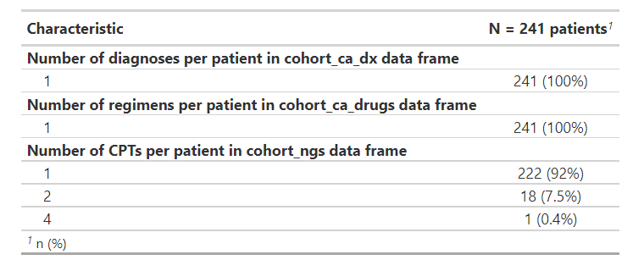
nsclc_cohort$tbl_overall_summary

Slide 47
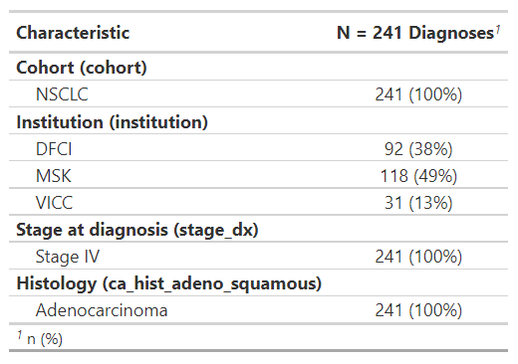
nsclc_cohort$tbl_cohort

Slide 48
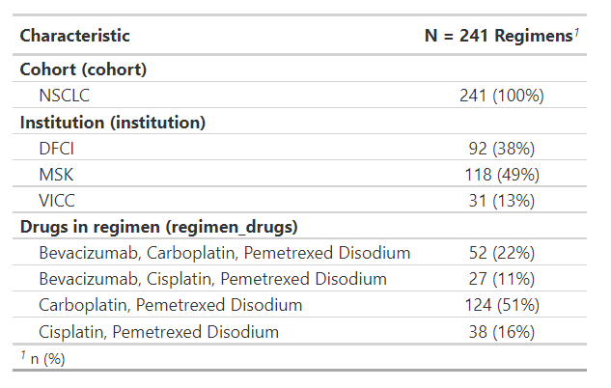
nsclc_cohort$tbl_drugs

Slide 49
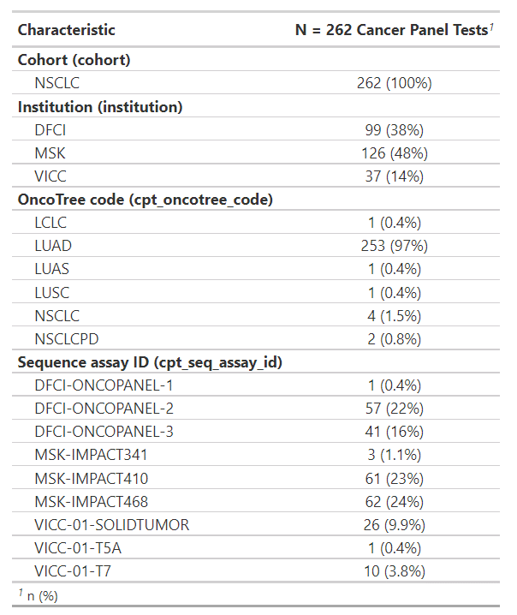
nsclc_cohort$tbl_ngs

Slide 50
Clinico-Genomic Data Processing Pipeline
Data stored on
Data import
synapse_version()
Indicates the versions of the data that are available to be specified in pull_data_synapse()
pull_data_synapse()
Imports GENIE BPC data from Synapse into the R environment
Data processing
create_analytic_cohort()
Selects an analytic cohort based on cancer diagnosis information and/or cancer-directed drug regimen information
select_unique_ngs()
Selects a unique next generation sequencing (NGS) test corresponding to the selected diagnoses
Data visualization
drug_regimen_sunburst()
Creates a sunburst figure of drug regimen information corresponding to the selected diagnoses in the order that the regimens were administered
Genomic Processing
{gnomeR}
create_gene_binary()
Processes data on mutation, CNA and fusions into analytic format
tbl_genomic()
Summarizes gene alterations across clinical variables of interest

Slide 51
drug_regimen_sunburst()
Visualize the complete treatment course for selected cancer diagnoses
Each ring corresponds to a regimen (i.e., innermost ring is first regimen, second innermost ring is second regimen, etc.)
Interactive figure: Can hover to see regimen names and percent of patients receiving that regimen
Notes:
Percent is percent of patients overall, e.g., 10.4% of patients received carboplatin + pemetrexed followed by Nivolumab

Slide 52
drug_regimen_sunburst()
Argument | Description | Acceptable Values
data_synapse | List returned from pull_data_synapse() | Name of object in global environment that was returned from pull_data_synapse()
data_cohort | The list returned from the create_analytic_cohort() function call | Name of object in global environment that was returned from create_analytic_cohort()
max_n_regimens | The maximum number of regimens displayed in the sunburst plot | Integer >0

Slide 53
Demo: drug_regimen_sunburst() for case study using NSCLC 2.0-public data
nsclc_sunburst <- drug_regimen_sunburst(
data_synapse = nsclc_synapse_data$NSCLC_v2.0,
data_cohort = nsclc_cohort)
Case Study: Create a cohort of patients who were diagnosed with Stage IV adenocarcinoma NSCLC and received Carboplatin and Pemetrexed +/- Bevacizumab or Cisplatin and Pemetrexed +/- Bevacizumab as their first cancer-directed drug regimen after diagnosis
Notes:
***Need to update sunburst image***

Slide 54
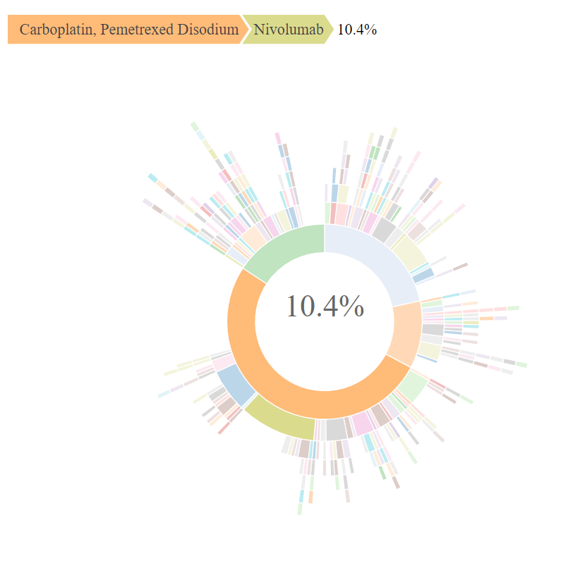
nsclc_sunburst$ sunburst_plot
Notes:
4:42

Slide 55
Clinico-Genomic Data Processing Pipeline
Data stored on
Data import
synapse_version()
Indicates the versions of the data that are available to be specified in pull_data_synapse()
pull_data_synapse()
Imports GENIE BPC data from Synapse into the R environment
Data processing
create_analytic_cohort()
Selects an analytic cohort based on cancer diagnosis information and/or cancer-directed drug regimen information
select_unique_ngs()
Selects a unique next generation sequencing (NGS) test corresponding to the selected diagnoses
Data visualization
drug_regimen_sunburst()
Creates a sunburst figure of drug regimen information corresponding to the selected diagnoses in the order that the regimens were administered
Genomic Processing
{gnomeR}
create_gene_binary()
Processes data on mutation, CNA and fusions into analytic format
tbl_genomic()
Summarizes gene alterations across clinical variables of interest
Notes:
Add sunburst
Rename select_unique_sample to select_unique_ngs
SB: intro through pull data synapse
JL: create analytic cohort, sunburst
SB: select unique NGS

